Slide 1
Barter System App
User Story , Work Flow and Wire Frame

Slide 2
User Story !!

Slide 3
Work of Administrator
The work of the administrator would be –
To make sure every user/doner is signed up and logged in.
To keep check that if 1 request of the user is pending the he/she can not make another request.
To see that requests are full filled.
Make sure requests are made after filling form.

Slide 4
Work of User/Requestor
The work of user would be –
To request for item he/she needs.
To fill form properly for making a request with correct information so that the doner is able to decide.

Slide 5
Work of Doner
The work of doner would be –
To provide proper information about the item they are providing.
To look at requests and decide , to whome he/she wants to donate the item.
To set filter on requests , so that they get the requests of only those items that they are donating.

Slide 6
Work Flow !!

Slide 7
Firstly the user and doner both need to sign up and log in.
Then the user can request for any item required by filling request form properly with correct information.
The doner would set filter for getting only the request of items they have to donate or sell.
It would be the doners choice that who to deliver means from any online shooping website or from his own.

Slide 8
Doner needs to check and read the notifications coming about the requests and decise to whome he/she wants to donate the item.
After getting any item the user can thank the doner and give feedback .

Slide 9
Wire Frame !!

Slide 10
Login Screen Structure

Slide 11
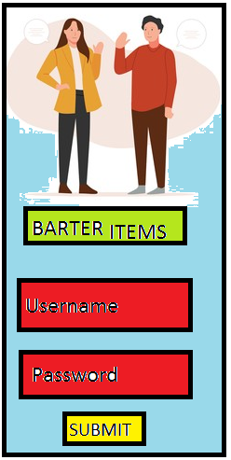

Slide 12
Home Screen Structure

Slide 13
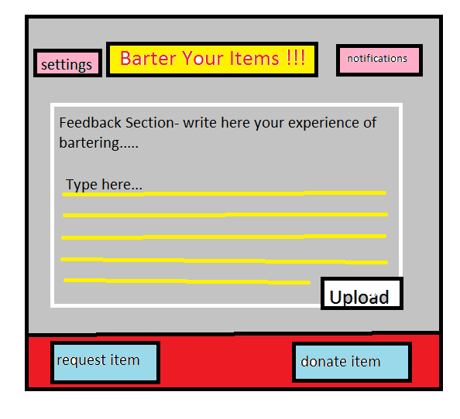

Slide 14
Request Screen Structure

Slide 15
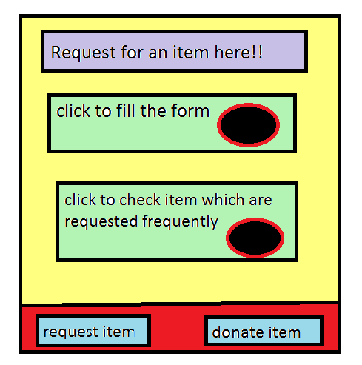

Slide 16
Donate Screen Structure

Slide 17
